Slide 1
Securing Critical Infrastructures In The Financial Sector The FinSec Dashboard
H2020 FINSEC – No 786727
1

Slide 2
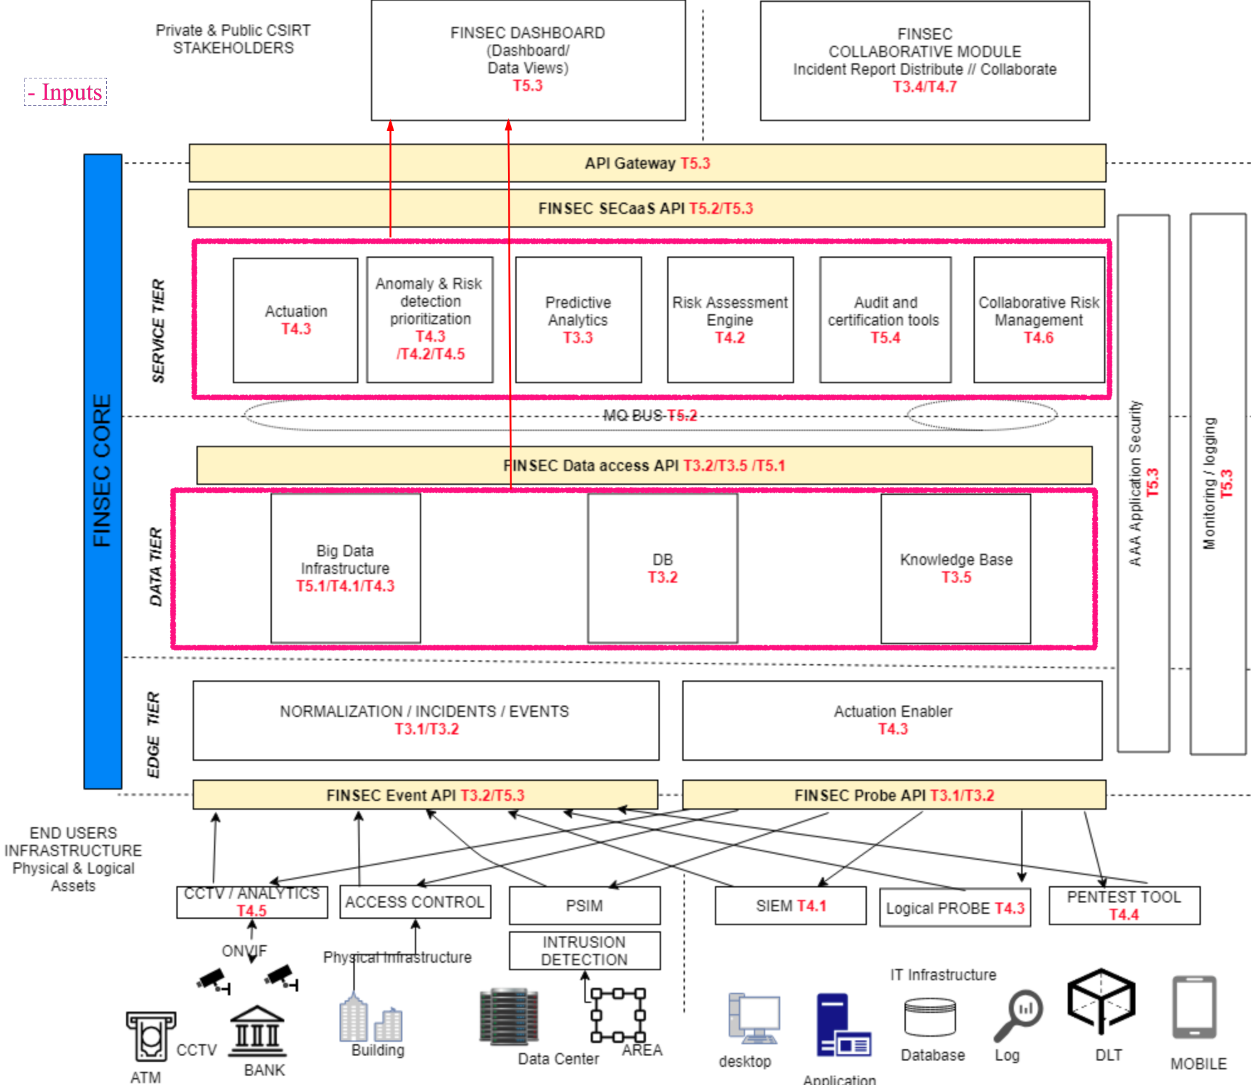
FINSEC – Dashboard – Architecture/Communication
Dashboard communicates with the FINSEC's Service Tier through the API gateway which exposes the endpoints provided by each service.
For infrastructure data it fetches information of the KB or the data tier trough the Data access API.

Slide 3
FINSEC – Dashboard – Inputs/Outputs
Inputs:
Dashboard Inputs will be produced by Security services. Data format follows the FINSTIX reference model.
Thus, all services need to provide their endpoints and output in FINSTIX format.
The following inputs have been identified:
Collaborative Risk Assessment Service - Services/Vulnerabilities/Regulation Violations/Risk (per Asset or Service)/Risk Configuration
Risk Assessment Engine - Risks per Asset/Risk models
Mitigation Service – Courses of action
Predictive Analytics Service – Attacks
TLS Assistant Service - Scans
Audit and certification Service – Libraries/Assets/Security models
Anomaly Detection Service - Attacks
Security knowledge base - CVE (Common Vulnerabilities) for each asset as well as their score (CVSS – Common Vulnerability Scoring System), TTPs (Malware/Tools/Threat Actors/Intrusion sets/Campaigns)
FINSEC's data tier – Infrastructure data - Assets/Organizations/Events/Observed Data/Agents/Probes/Probe Configuration/Areas

Slide 4
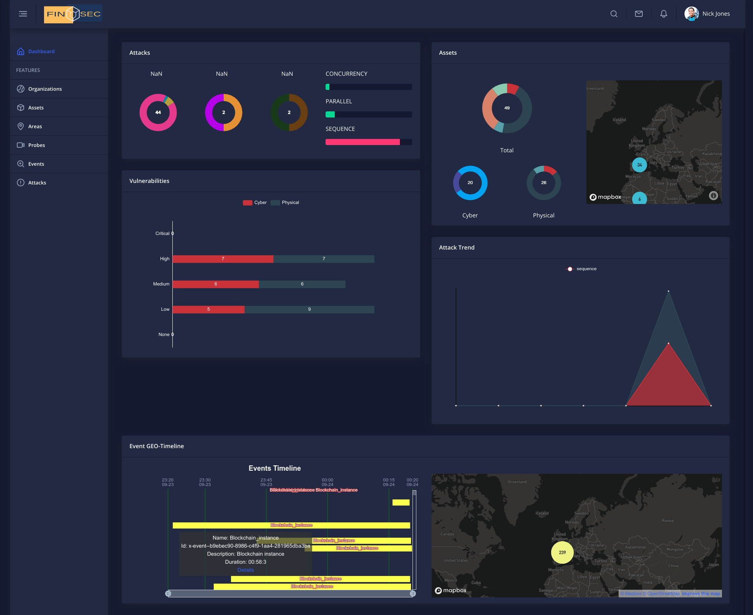
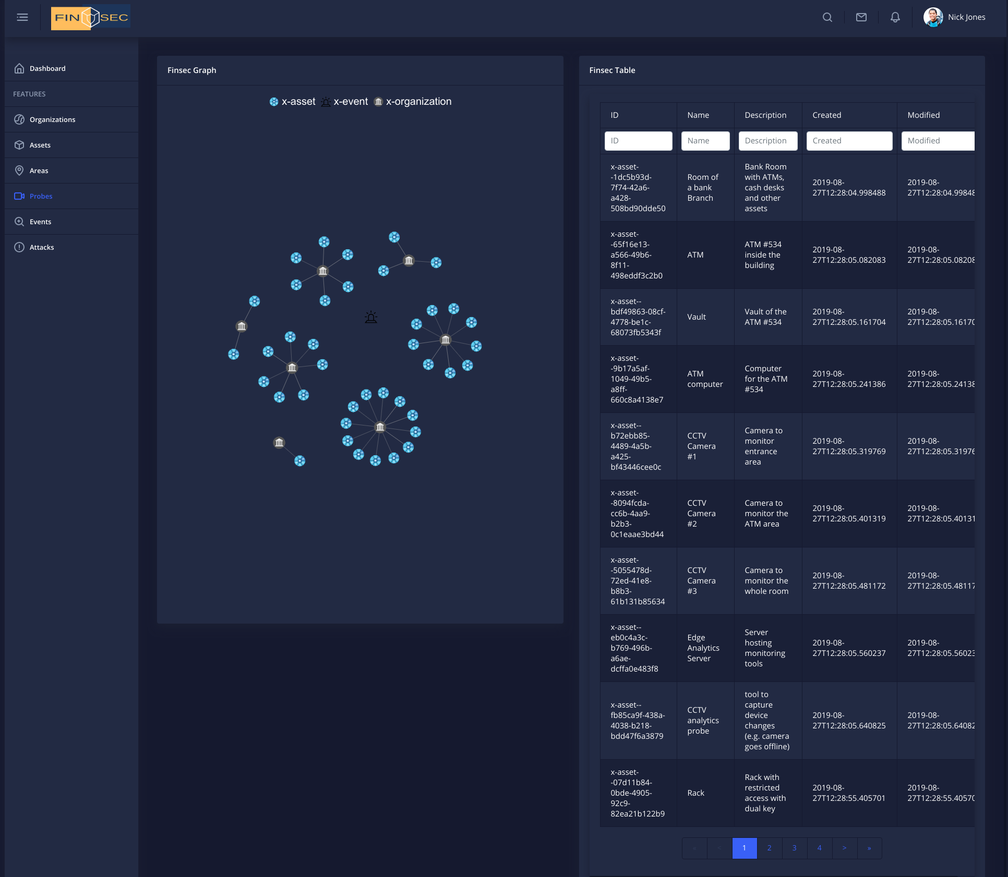
FINSEC – Dashboard – Inputs/Outputs
Outputs
Output of the FINSEC dashboard is a graphical representation of the inputs in the following formats:
Trend graphs
Pie charts
Maps Containing SDOs geo-location information
Relation graphs
Paginated sortable/searchable tables
Modals to illustrate more details
Timeline to display events in specified intervals

Slide 5
FINSEC – Dashboard – Technology
Dashboard is already containerized and deployed in the FINSEC platform. It is built using Angular 9 and Laravel. The Dashboard follows the new design reviewed by the service owners
Charting is based on Apache 2 licensed library named eCharts
Fetches data from the data tier and displays trends, relationships and stats which were produced both by the probes and the service tier
Provides drill down operation for stored FINSTIX object details
Requests data using JWT authentication (AAA through API gateway and keycloak)
Supports multitenancy (by datalayer design)
Supports Object reading/creation/deletion/update (forms and dual lists to create/edit objects)
Supports realtime notifications (mongdb change streams)

Slide 6
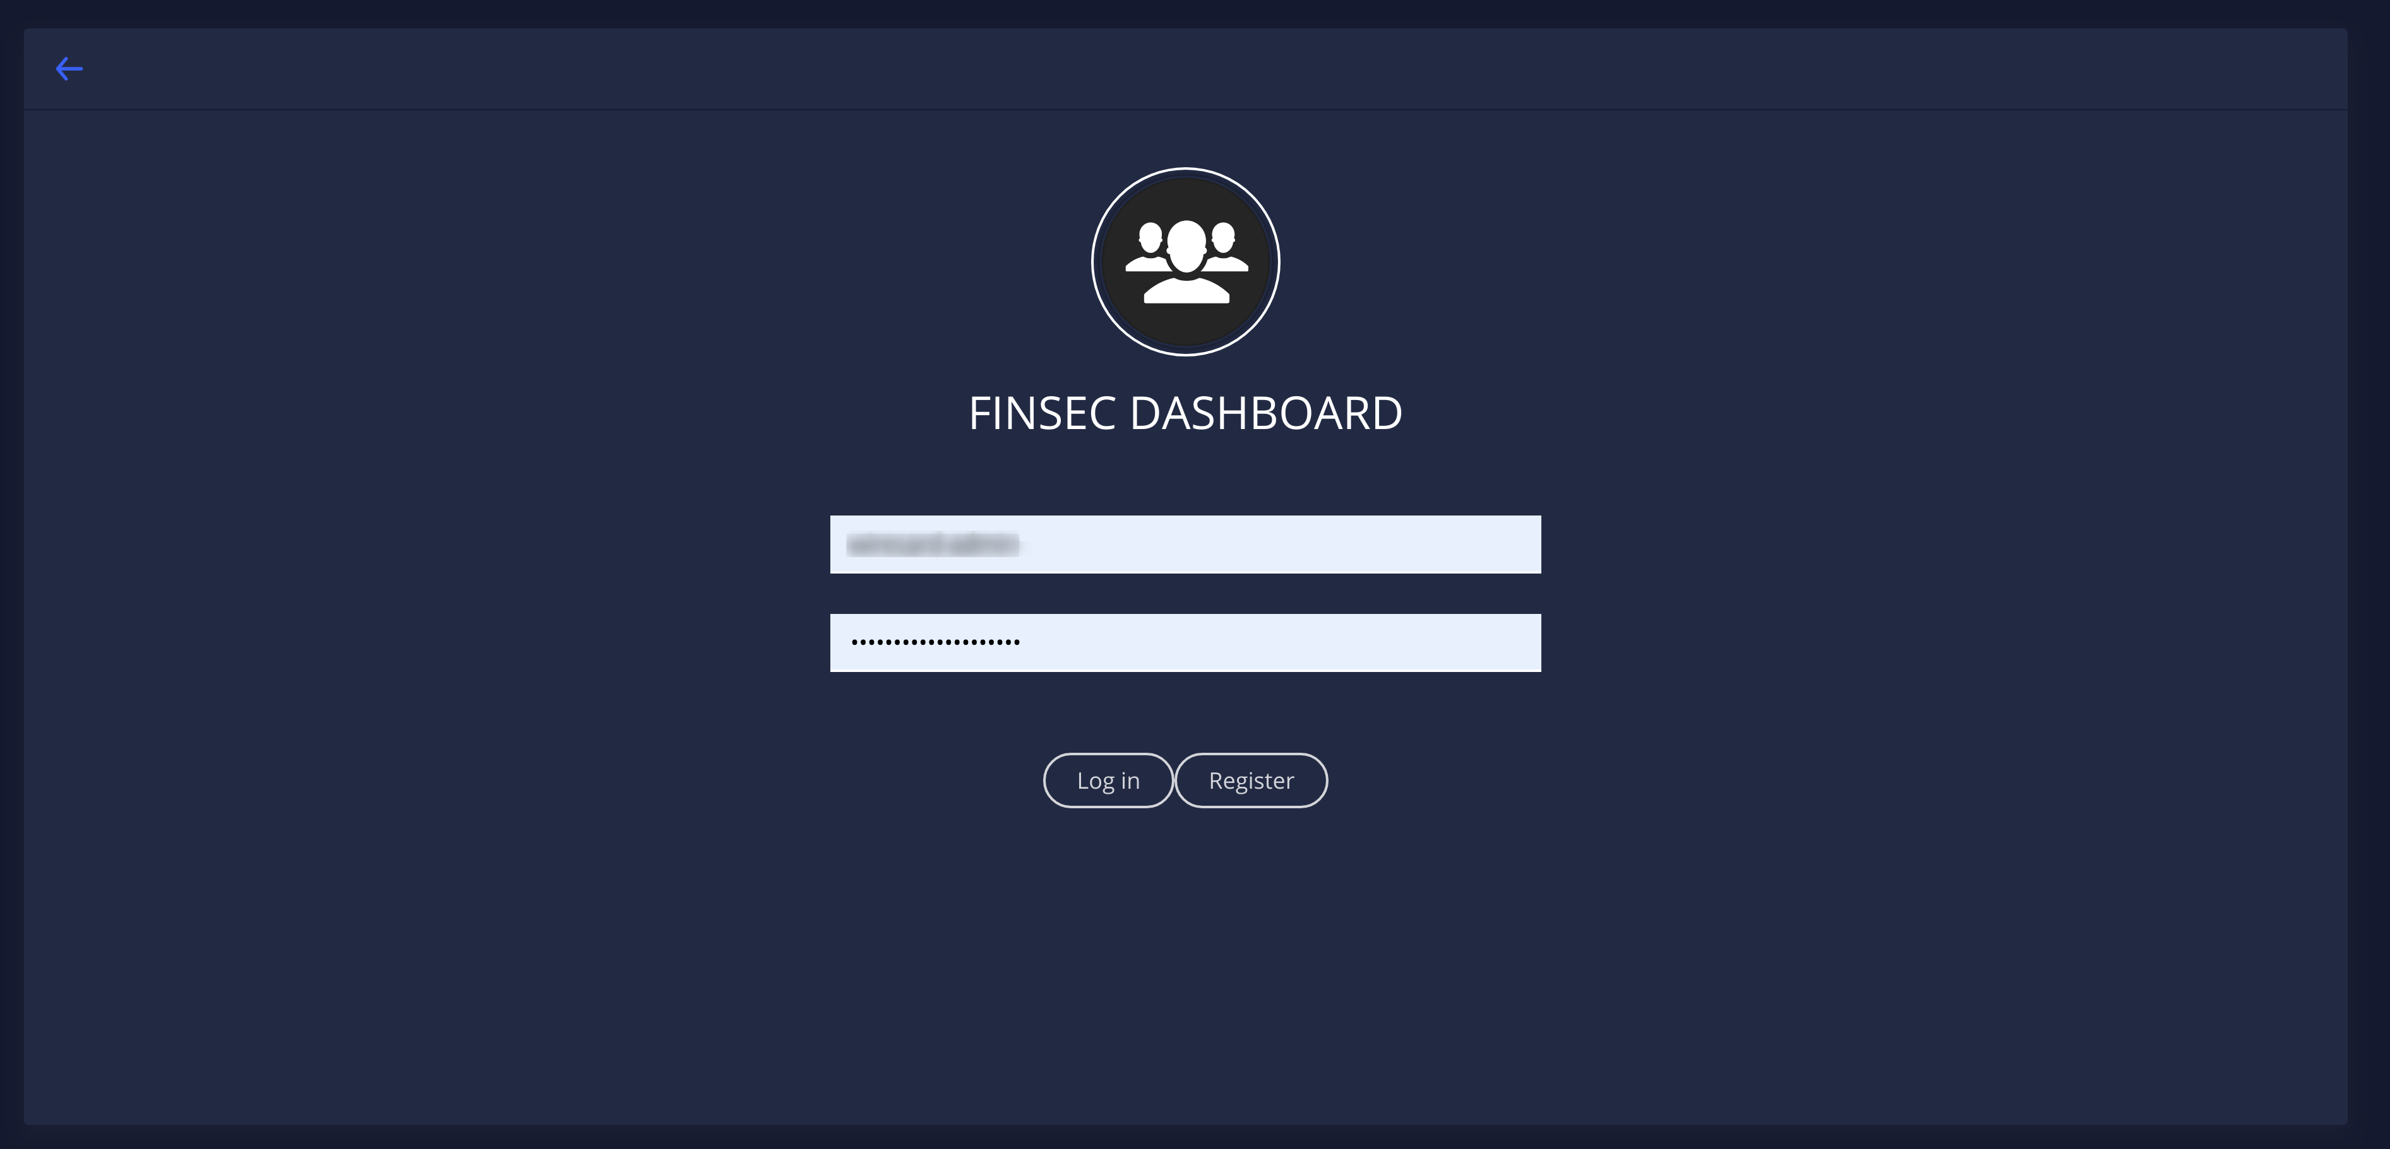
FINSEC – Dashboard – Login Page
The following figure presents the Dashboard's login page

Slide 7
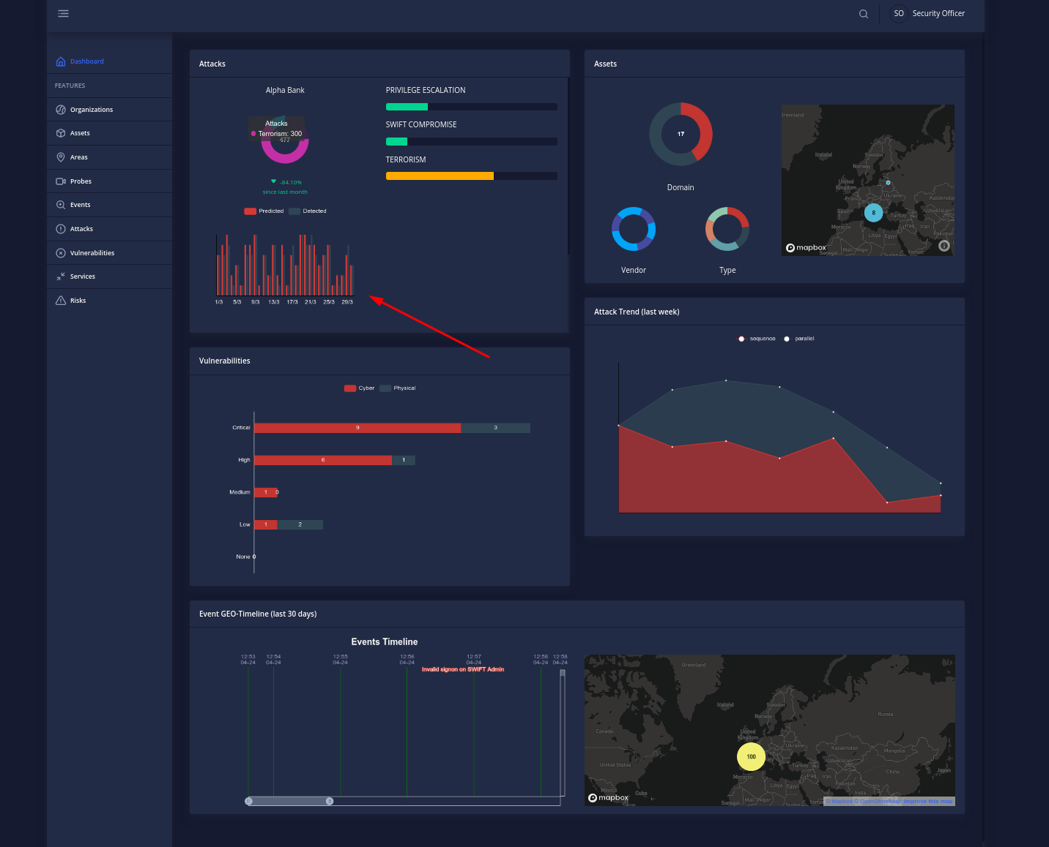
FINSEC – Dashboard – Home Page
The home page displays the last month detected and predicted attacks by type, the assets of the Organization (grouped by domain vendor and type), the system's detected vulnerabilities, an attack trend (for the current week) and an event timeline. When needed a map with geolocation is available

Slide 8
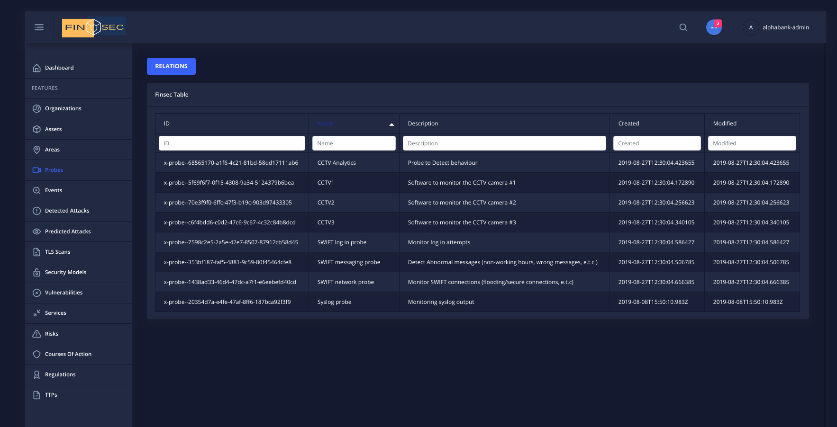
FINSEC – Dashboard – Filtering/Sorting
Table views provided can be filtered or sorted by column. On the left we can see the filtering of the name column while on the right the sorting on the same column

Slide 9
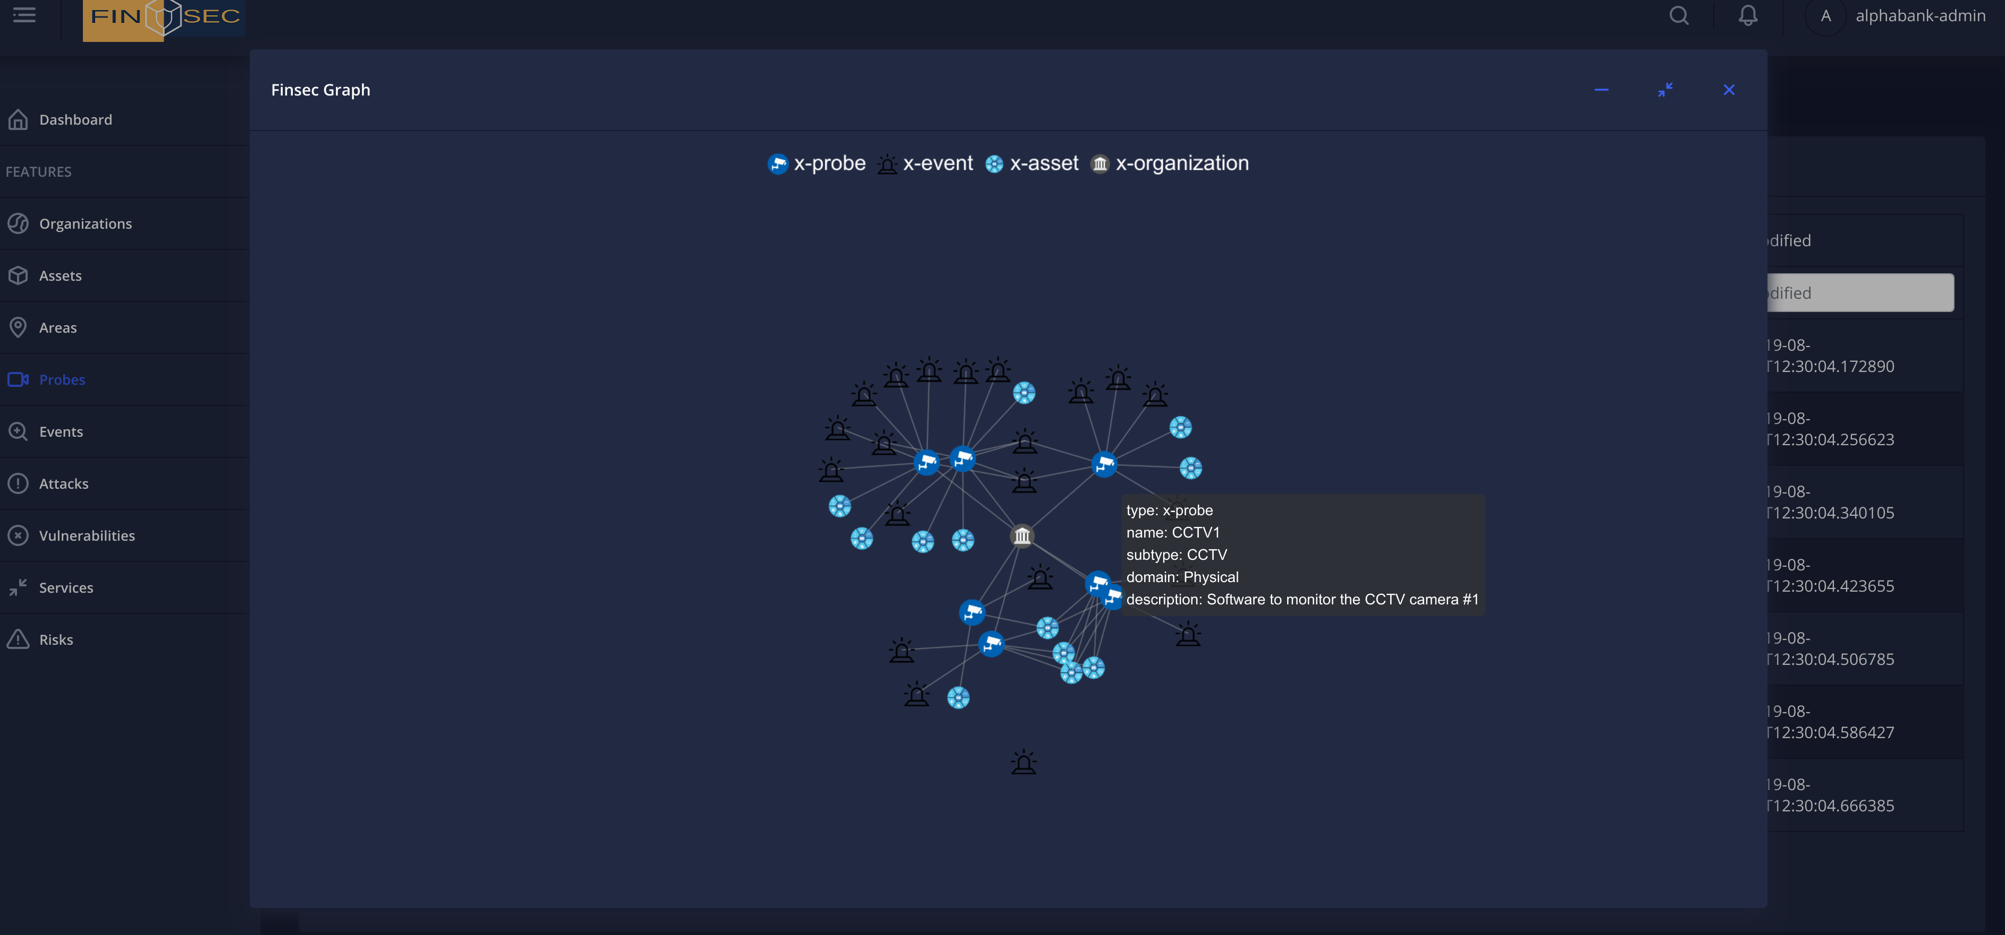
FINSEC – Dashboard – Relations
In each detail page of the FINSEC dashboard a security officer can click on the Relations button. The result is a node graph with all model object references

Slide 10
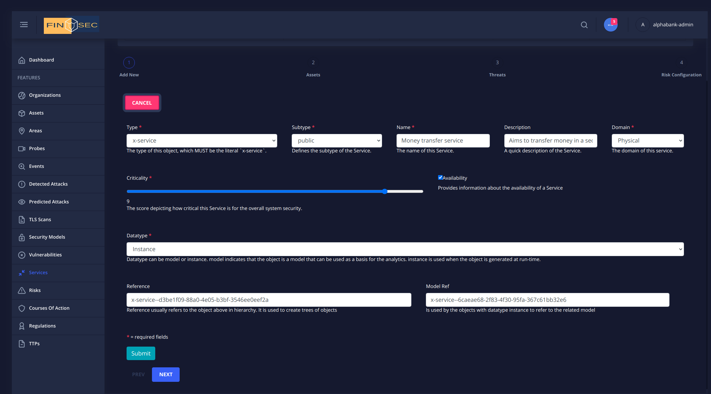
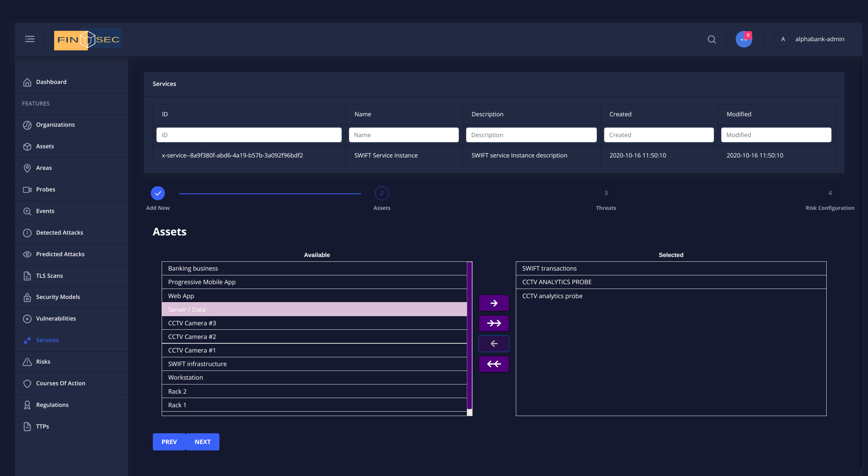
FINSEC – Dashboard – CRUD operations
A security officer may even generate objects that will be stored inside the platform. The figure on the left displays a form to generate a new service (x-service object). A dual list is used in case an association is needed (right hand side)

Slide 11
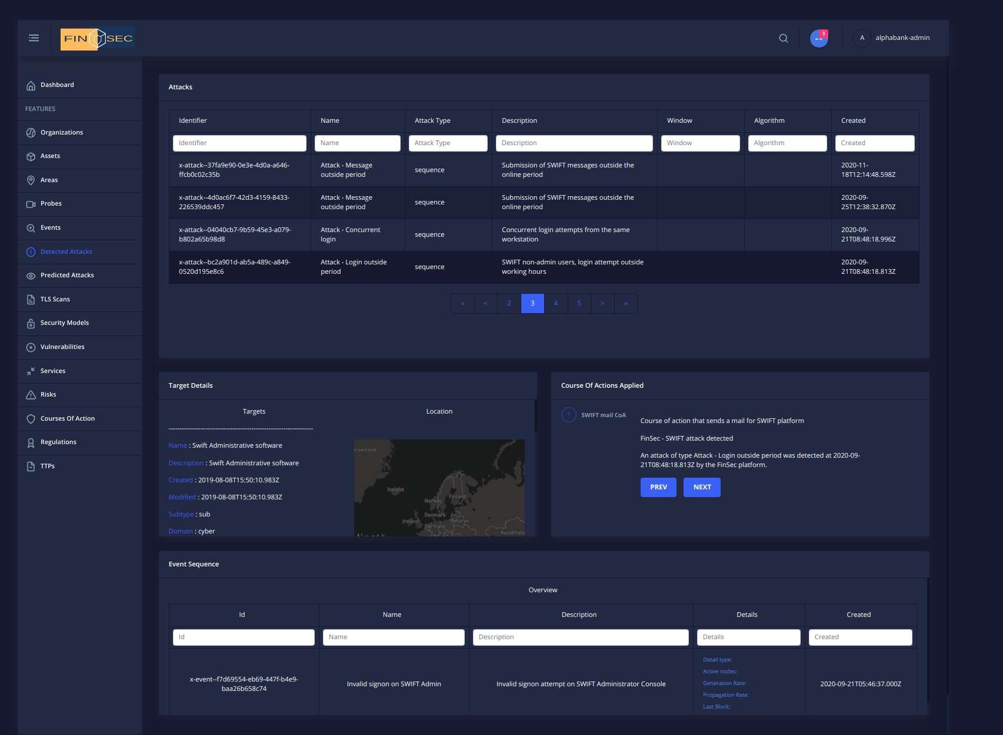
FINSEC – Dashboard – Predicted/Detected Attacks
The next figure presents the outcomes of the anomaly detection service. After clicking the attack row, the security officer is provided with a list of assets involved, the event sequence that led to the attack as well as a set of courses of actions applied by the Mitigation Service

Slide 12
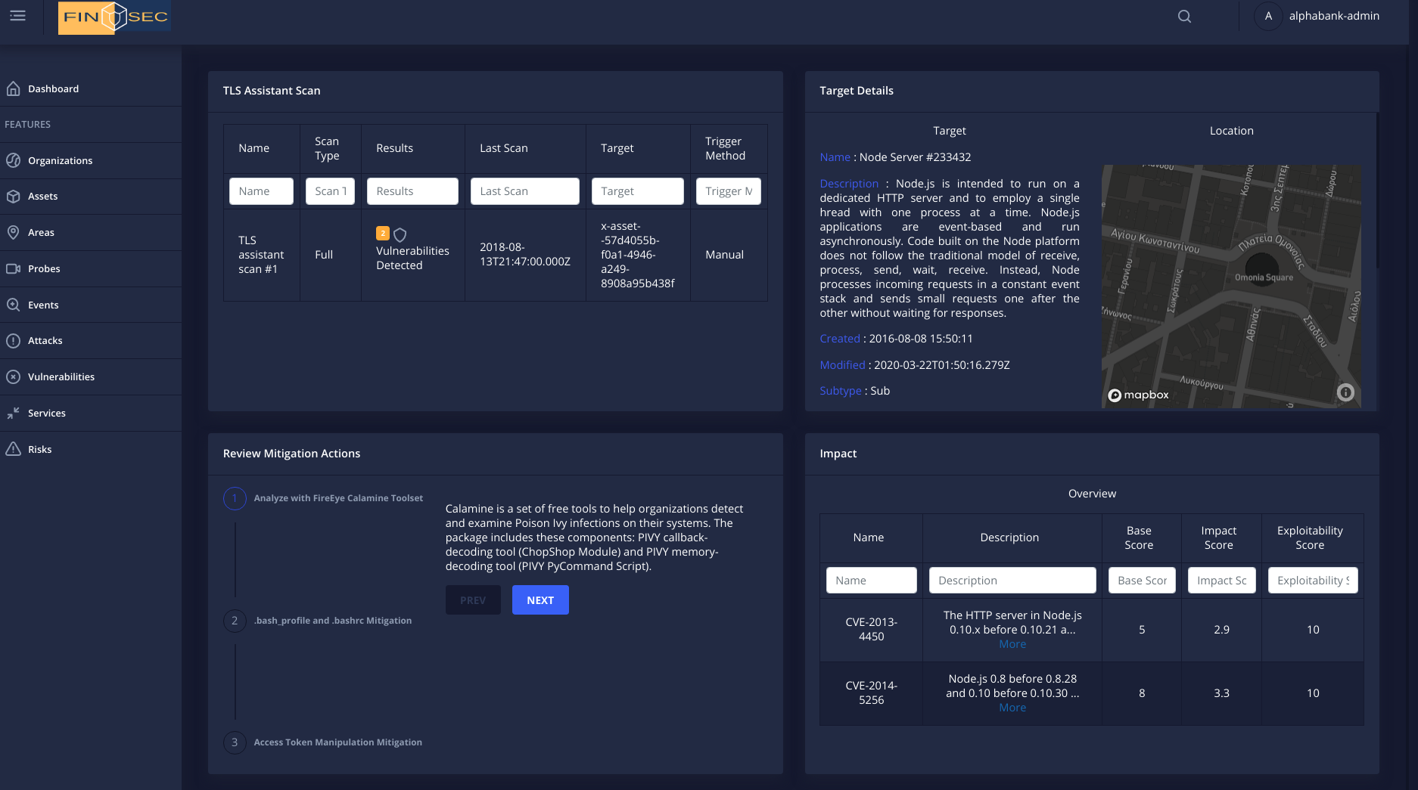
FINSEC – Dashboard – TLS Scans
TLS scans, are the outcomes of the TLS assistant service. Under the corresponding tab, Dashboard displays the scanned asset details, the mitigation actions applied, and the vulnerabilities detected

Slide 13
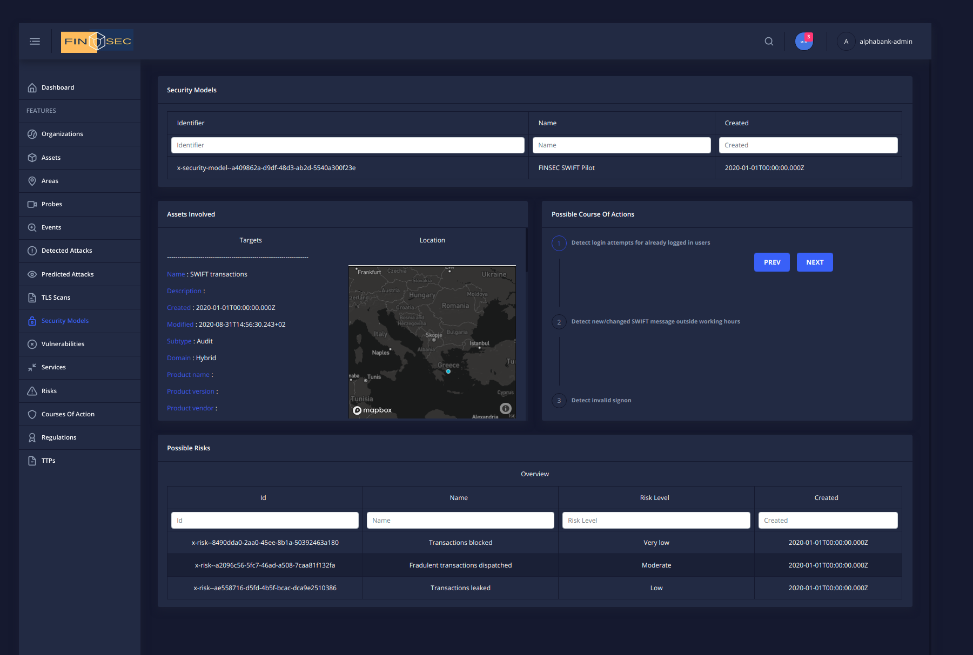
FINSEC – Dashboard – Audit and Certification (security models)
Under "Security Models" tab, the Dashboard illustrates the Audit Service outcomes. The Risks, the courses of actions and the assets involved based on internal tool libraries

Slide 14
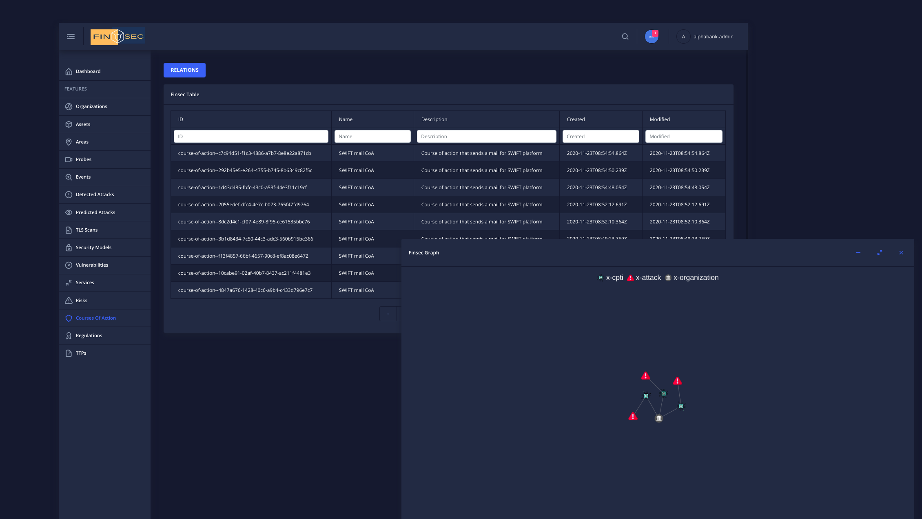
FINSEC – Dashboard – Mitigation (Courses of action)
Under courses of actions tab, Dashboard holds the outcomes of the mitigation service

Slide 15
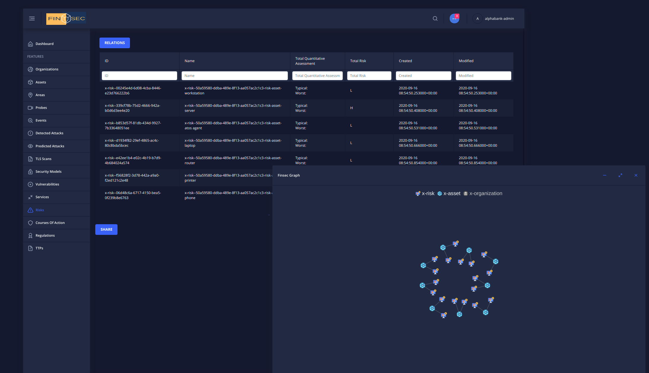
FINSEC – Dashboard – Risk Assessment Engine
Under risks tab, RAE outcomes include a list of risks detected for the organization as well as the relationships with the assets scanned

Slide 16
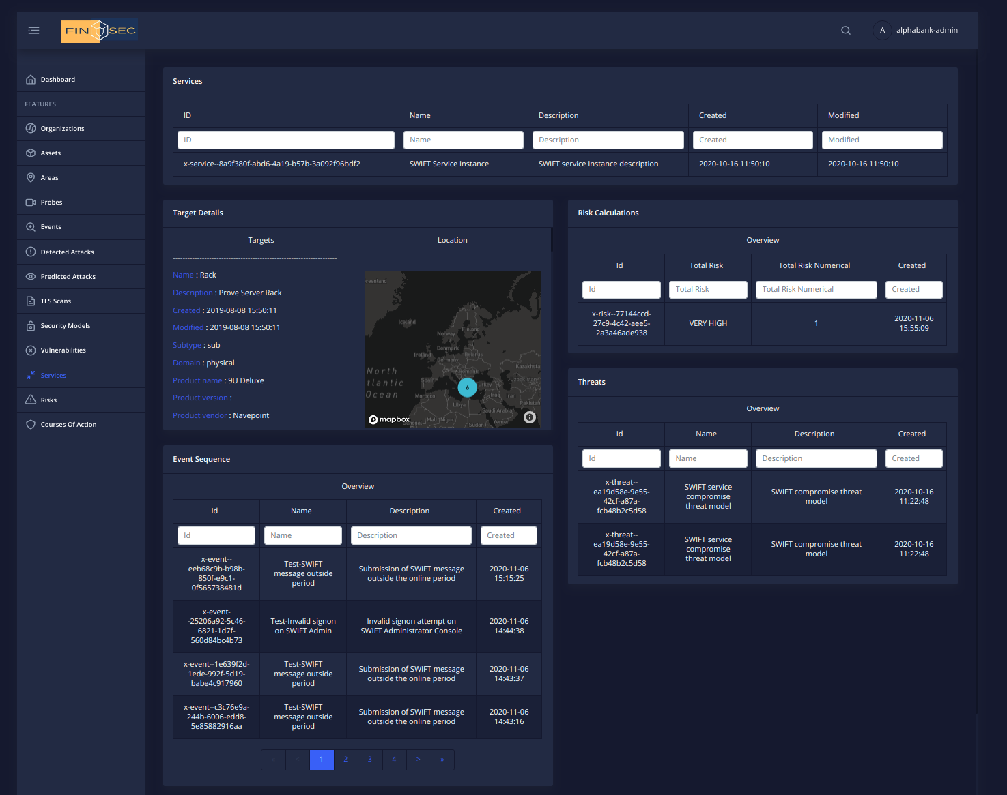
FINSEC – Dashboard – Collaborative Risk Assessment
The latest risk calculation for each service threat is provided under "Services" tab. A service, may have more than one threats, thus an officer may select another one and examine the risk value. The assets involved in the calculation as well as the event sequence that led to the last estimation are also displayed as part of the Collaborative Risk Service outcomes

Slide 17
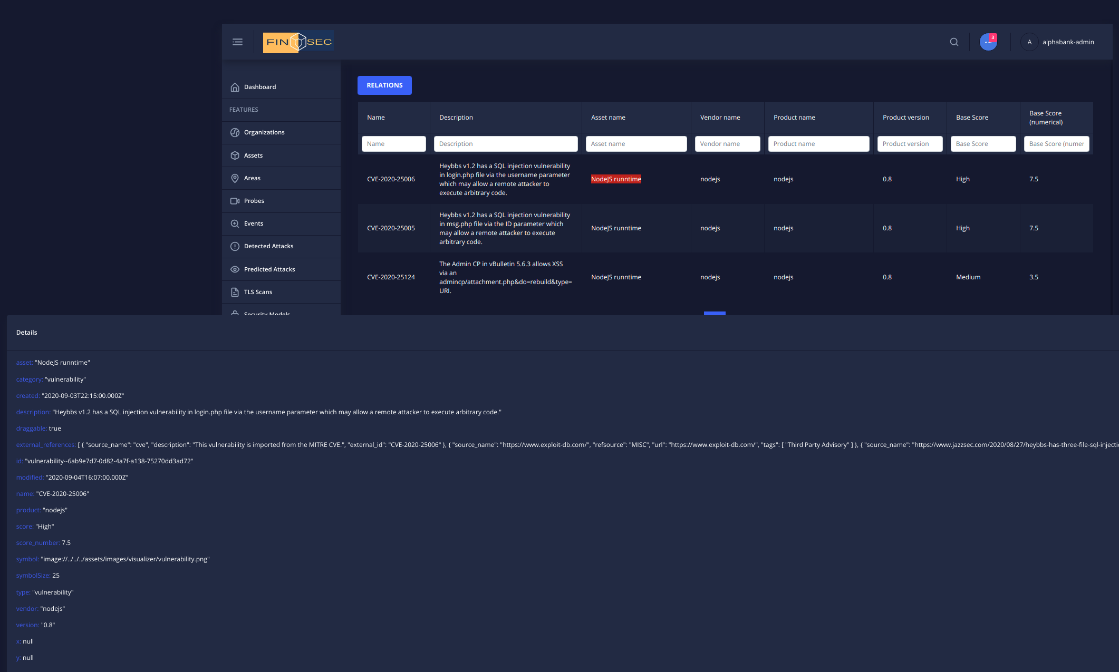
FINSEC – Dashboard – Security KB (vulnerabilities)
The asset vulnerabilities are provided by the Security Knowledge Base which makes use of sources like CVE and CWE. Their score is again calculated based on CVSS. The results of KB are presented in the next figure

Slide 18
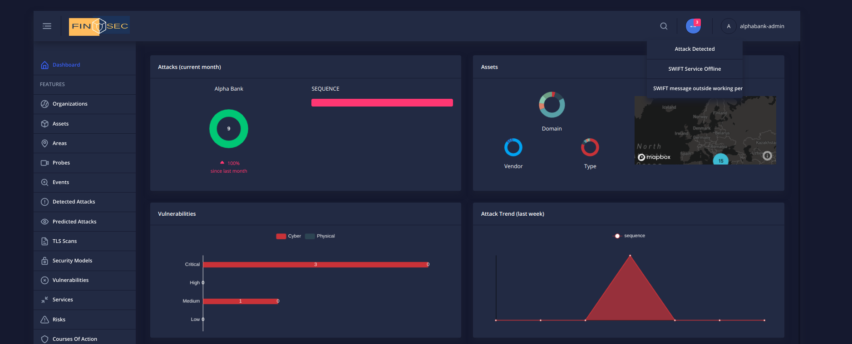
FINSEC – Dashboard – Notifications
Based on the data-layer's change streams and a webscocket implementation, the Dashboard is updated in real-time. Almost all charts and the bell on the right-hand side, are updated based on changes in the data-layer or blockchain transactions

