Slide 1
Securing Critical Infrastructures In The Financial Sector Collaborative Risk Assessment .
H2020 FINSEC – No 786727
1

Slide 2
Collaborative Risk Assessment Service
The service targets the extension of the MITIGATE project, to perform risk assessment operations both for cyber and physical domain in the Financial Supply Chain.
The Risk Assessment platform needs to be compliant with the FINSTIX data model. In addition, the calculations need to be precise and resource friendly.
The collaboration protocols used as well as the risk assessment triggers are crucial for the successful completion of the current task.
Additionally, the service delivers a web-based tool (integrated in the FINSEC dashboard) for collaborative security processes (including assessment and mitigation) in the scope of the financial supply chain.

Slide 3
Collaborative Risk Assessment Service – Blockchain
The Hyperledger Fabric was used as a backbone infrastructure of the FINSEC collaborative blockchain approach.
Robustness, trust models and seamless collaboration are only a few of the benefits of the tool developed.
The following endpoints publicly available and may be used by all the peers registered in the blockchain.
POST @ ‘/api/users/login’: Logs in the user to the HF network by their credentials and returns a session authentication JWT.
POST @ ‘/users/createUser’: Registers a new user in an organisation’s peer node.
POST @ ‘/transaction/CreateTransaction’: Creates a new transaction block that contains a message on behalf of the user’s organization and publishes it on the HF ledger. Each transaction contains a hash of its contents and consequently of the message and can be used to verify its integrity.
POST @ ‘/transaction/UpdateTransaction’: Updates a pre-existing transaction with new information.
The outputs of the API application are:
GET @ ‘/api/users/isExist’: Finds a user by the username and returns true if found. This request is used at an unsecured endpoint for registration.
GET @ ‘/api/users/QueryUser: returns a full user object from the user ID passed in the params.
GET @ '/transation/QueryTransaction': Returns a full transaction object based on the ID passed in the transaction parameters via the smart contract. More specifically, this request uses the message unique ID to query the ledger and return the transaction that contains it.
GET @ '/transation/QueryAllTransaction': Returns a list of all transactions submitted by a particular organisation.
GET @ '/transation/GetTransationHistory': Returns the full history all the previous versions edited of a particular transaction.

Slide 4
Collaborative Risk Assessment Service – Risk Assessment Flow
A security officer initializes a Service object using the Dashboard
In a next step he is asked to fill in the details and add the assets which compose the Service
The Threats (x-threat) and Event models related to them are then provided and attached to the current service
The security officer submits the form. The form is then forwarded from the Dashboard to the MITIGATE tool

Slide 5
Collaborative Risk Assessment Service – Risk Assessment Flow (cont.)
MITIGATE communicates with the Security KB and detects the vulnerabilities for all the assets involved
The initial risk value is calculated and a x-risk object is produced and stored for the current Service
MITIGATE keeps an open stream to the FINSEC data-layer. For each event or vulnerability change the Risk of the Service is recalculated

Slide 6
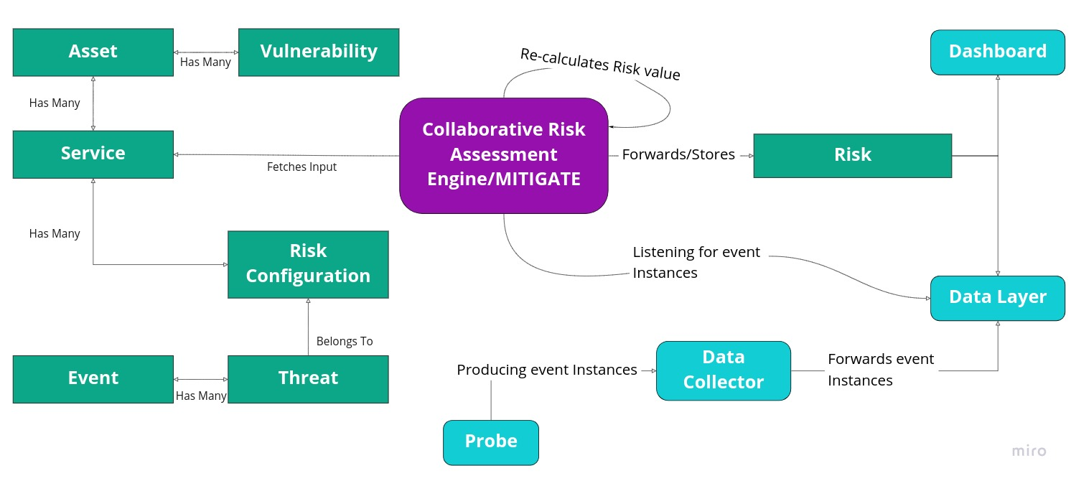
Collaborative Risk Assessment Service – Component interaction
Risk Assessment Flow

Slide 7
Collaborative Risk Assessment Service – Service Creation
The following figure shows the form used to generate a new service (x-service FINSTIX object)

Slide 8
Collaborative Risk Assessment Service – Asset association
Next up, a security officer is requested to select the assets that form the service. A dual list makes this step easier

Slide 9
Collaborative Risk Assessment Service – Threat generation/association
As a next step, the security officer, creates or associates a threat to the new service. After filling all the service details, the Collaborative risk assessment, in real time, provide risk calculations, according to the events coming by probes

Slide 10
Collaborative Risk Assessment Service – Results
Under Services tab, the FINSEC Dashboard displays a list of services and by clicking each row, the service's assets, the threats defined, the risk calculations and the events that lead to this calculation are presented in table view

Slide 11
Collaborative Risk Assessment Service – Collaboration Scenario
The scenario that will be described in the next slides, refer a submission of regulation violation to a regulation authority. More specifically:
A blockchain registered peer logins the stand-alone web-based tool
A security officer submits a new regulation violation
The regulation authority checks all the transactions
A new transaction is detected (in the blockchain web based tool)
The regulation authority reads the transaction details

Slide 12
Risk Assessment and Mitigation in the Financial Supply Chain – Blockchain login
The following figure displays the login form of the stand-alone web-based tool. Submitting the correct credentials a regulation authority or stakeholder, can connect to the tool.

Slide 13
Collaborative Risk Assessment Service – Regulation creation
Let's assume a security officer detects a regulation violation. They fill the following FINSEC Dashboard form and submit the violation to the blockchain (createTransaction) endpoint.

Slide 14
Collaborative Risk Assessment Service – Blockchain list transactions
Regulation Authority – list of all transactions

Slide 15
Collaborative Risk Assessment Service – Blockchain transaction details
Regulation Authority – transaction details

Slide 16
Collaborative Risk Assessment Service – Technologies used Advantages
FINSTIX
JSON messages (fast and reliable)
STIX compatibility
Physical Domain support
MITIGATE
Background Jobs (resources/calculations on demand)
Containirized (Scalability – SECAAS)
Laravel (Popular PHP Framework, Seemless integrations, Easy Testing)
Knowlwdge Base Integration
CVE (industry standard) and other sources of security knowledge
MITIGATE becomes lighter and service oriented
Ability to provide custom Physical vulnerabilities

Slide 17
Collaborative Risk Assessment Service – FINSEC Innovation
Unify Risk Assessment processes for both cyber and physical domain
Definition of hybrid services inside an organization (physical and cyber assets)
Financial Service examination and definition
Instant reports to regulation authorities to avoid penalties
Collaboration of institutions for a more complete risk evaluation
Distributed access and trust model definition for the collaboration peers

Slide 18
Collaborative Risk Assessment Service – Achievements
FINSTIX Compatibility
New Objects created (Service, Risk, Risk Configuration, Threat)
MITIGATE fully compatible with FINSTIX
Containerized Application
Multitenancy
Knowledge Base Integration
Service/Threat Definition – Service Reports
Compliance with GDPR and NIS
SECAAS
WP5: Insights on the deployment
Multiple organizations supported
Data accessible only by owners
Communication with FINSEC's data layer
Vulnerabilities that trigger a new Risk calculation
Risk evaluation and reports for Services defined
Service Definition
Threat Definition (threats targeting a Service and events/risk configuration that affect the calculations)
Vulnerabilities targeting both assets and Services
Threats
Pilot Assessment
Successful Pilot use cases (without blockchain integration)
Dashboard Integration and results demonstration
Communication with Security Knowledge Base
APIs for component interconnection
Representation of violations in a unified format
Blockchain Integration
Distributed
Stable and secure transactions
Trust model definition (sensitive data)

