Slide 1
Securing Critical Infrastructures In The Financial Sector
The Importance of Integrated Information Modelling and Semantic Interoperability
H2020 FINSEC – No 786727
1

Slide 2
Attacks and security in financial institutions
Cyber-physical security of financial institutions is a critical topic
The number of cybersecurity incidents is growing
Financial institutions must increase their robustness against attack vectors
Cyber and Physical security act in isolation
Inaccurate vulnerability assessment and risk analysis

Slide 3
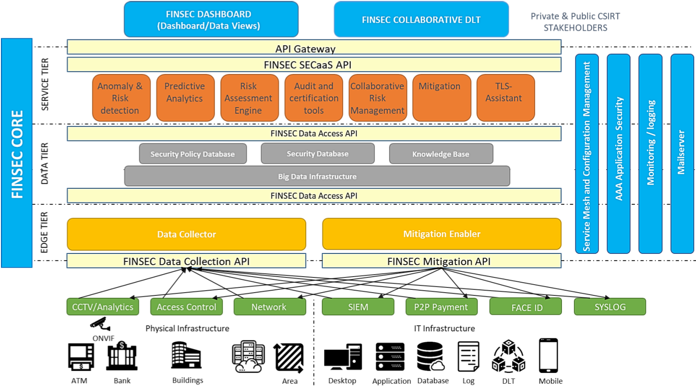
The FINSEC Reference Architecture

Slide 4
The importance of a Data Model
A common and strict semantic to enable
Semantic interoperability
Automated processing
Collaboration among the different security services
The security services must process information on both cyber and physical systems
A proper data model that considers all the requirements of the security services is fundamental

Slide 5
DO NOT reinvent the wheel
Security Knowledge Base
Collects information from external sources of Cyber Threat Intelligence
Exposes this information to the security services
Stores the results of Cyber-Physical Threat Intelligence
Standard formats for Cyber Threat Intelligence DO exist
Standard formats for Cyber-Physical Threat Intelligence DO NOT exist
Two approaches
Create a brand-new data model
Extend an existing data model

Slide 6
The FINSTIX Data Model
FINSTIX
Data model shared by the services of the FINSEC Platform
The format used to store information in the Data Tier
FINSTIX = FINSEC + STIX
FINSTIX is an extension of the OASIS STIX2 standard
New custom objects to cope with Logical and Physical incidents
FINSTIX can be used also in any context of Critical Infrastructure

Slide 7
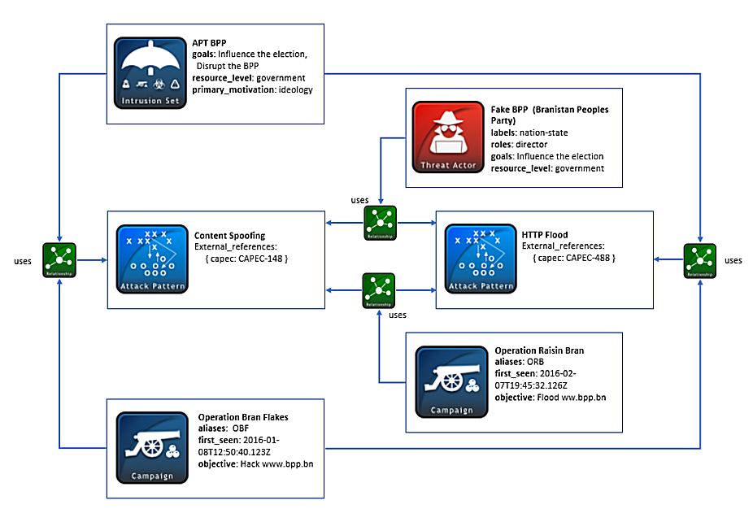
OASIS Structured Threat Information eXpression
STIX
Standardized serialization format used to share Cyber Threat Intelligence (CTI)
One of the most used CTI standards
One of the most promising strategies in the cyber security topic
Easily readable by humans and machines
Defines the main entities usually involved in CTI and the relationships among them

Slide 8
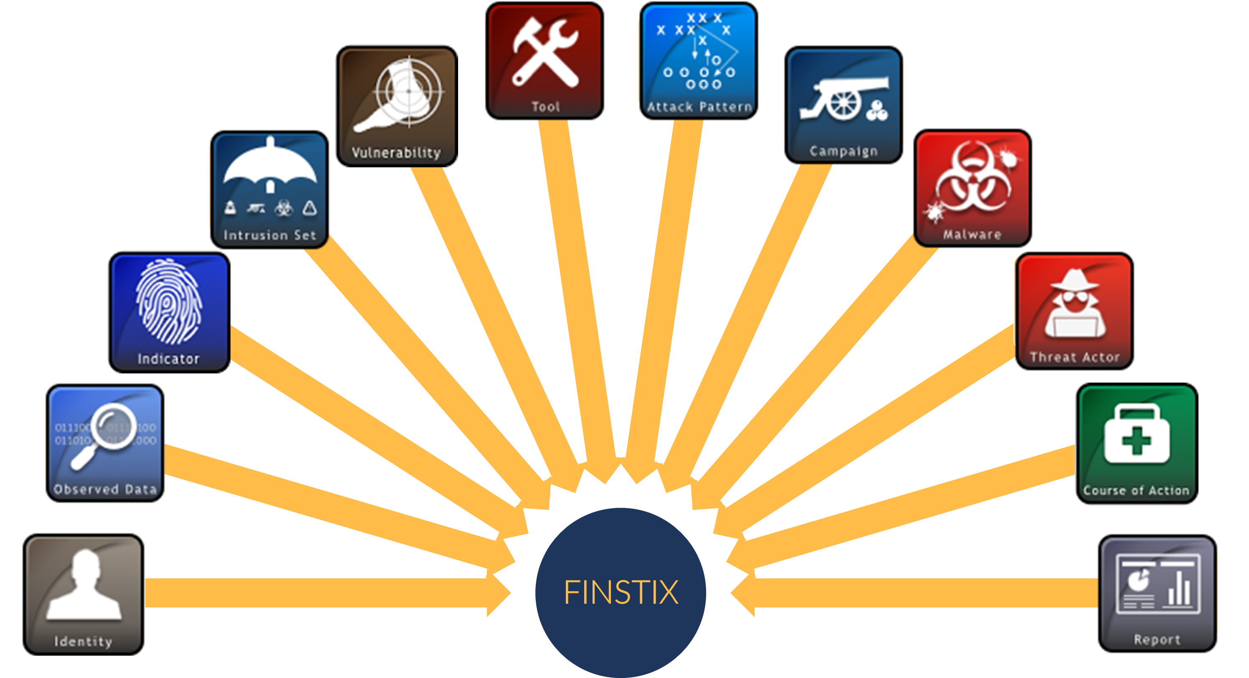
The FINSTIX Domain Objects
Organization
Area of Interest
Asset
Probe
Event
Agent
Vulnerability Score
Attack
CPTI
…

Slide 9
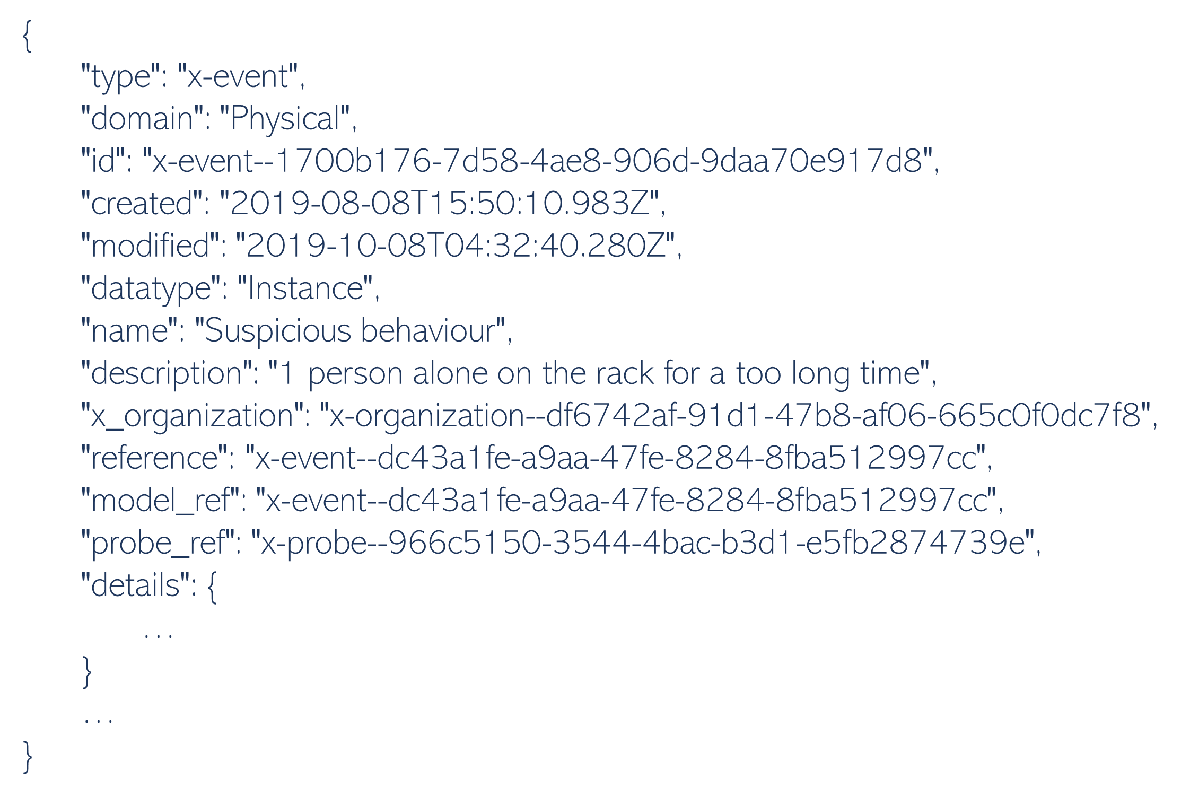
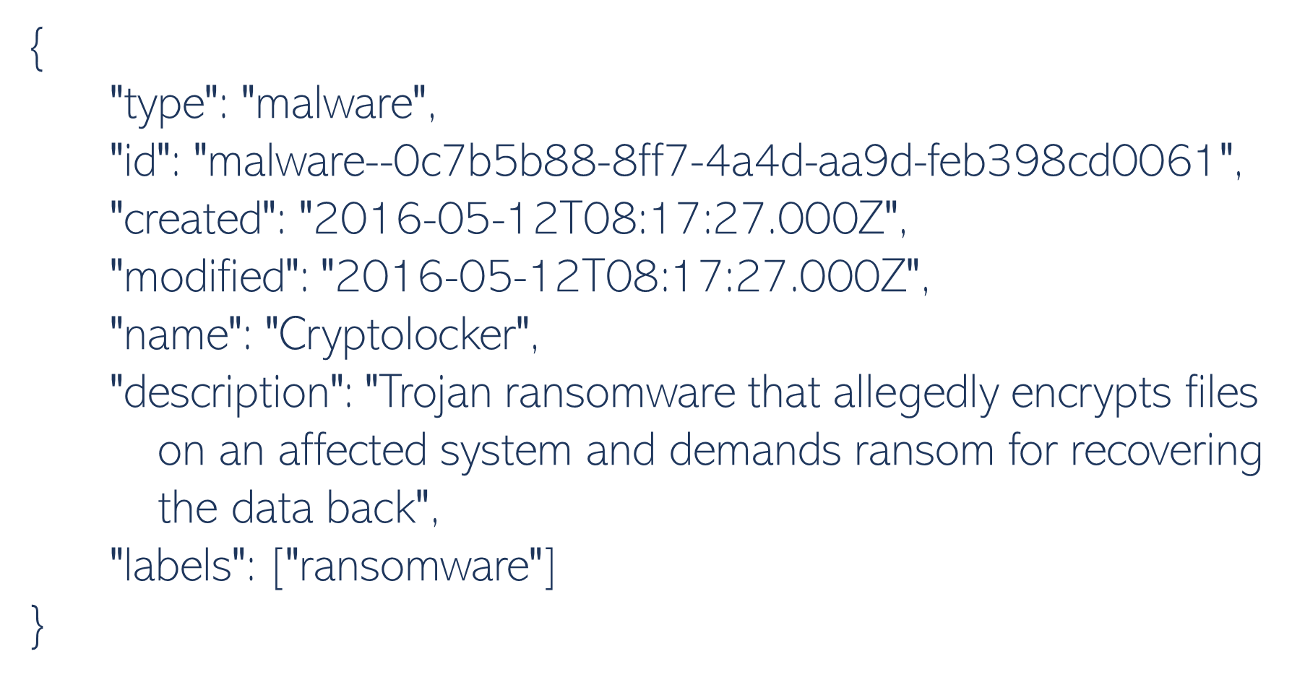
From STIX2 to FINSTIX

Slide 10
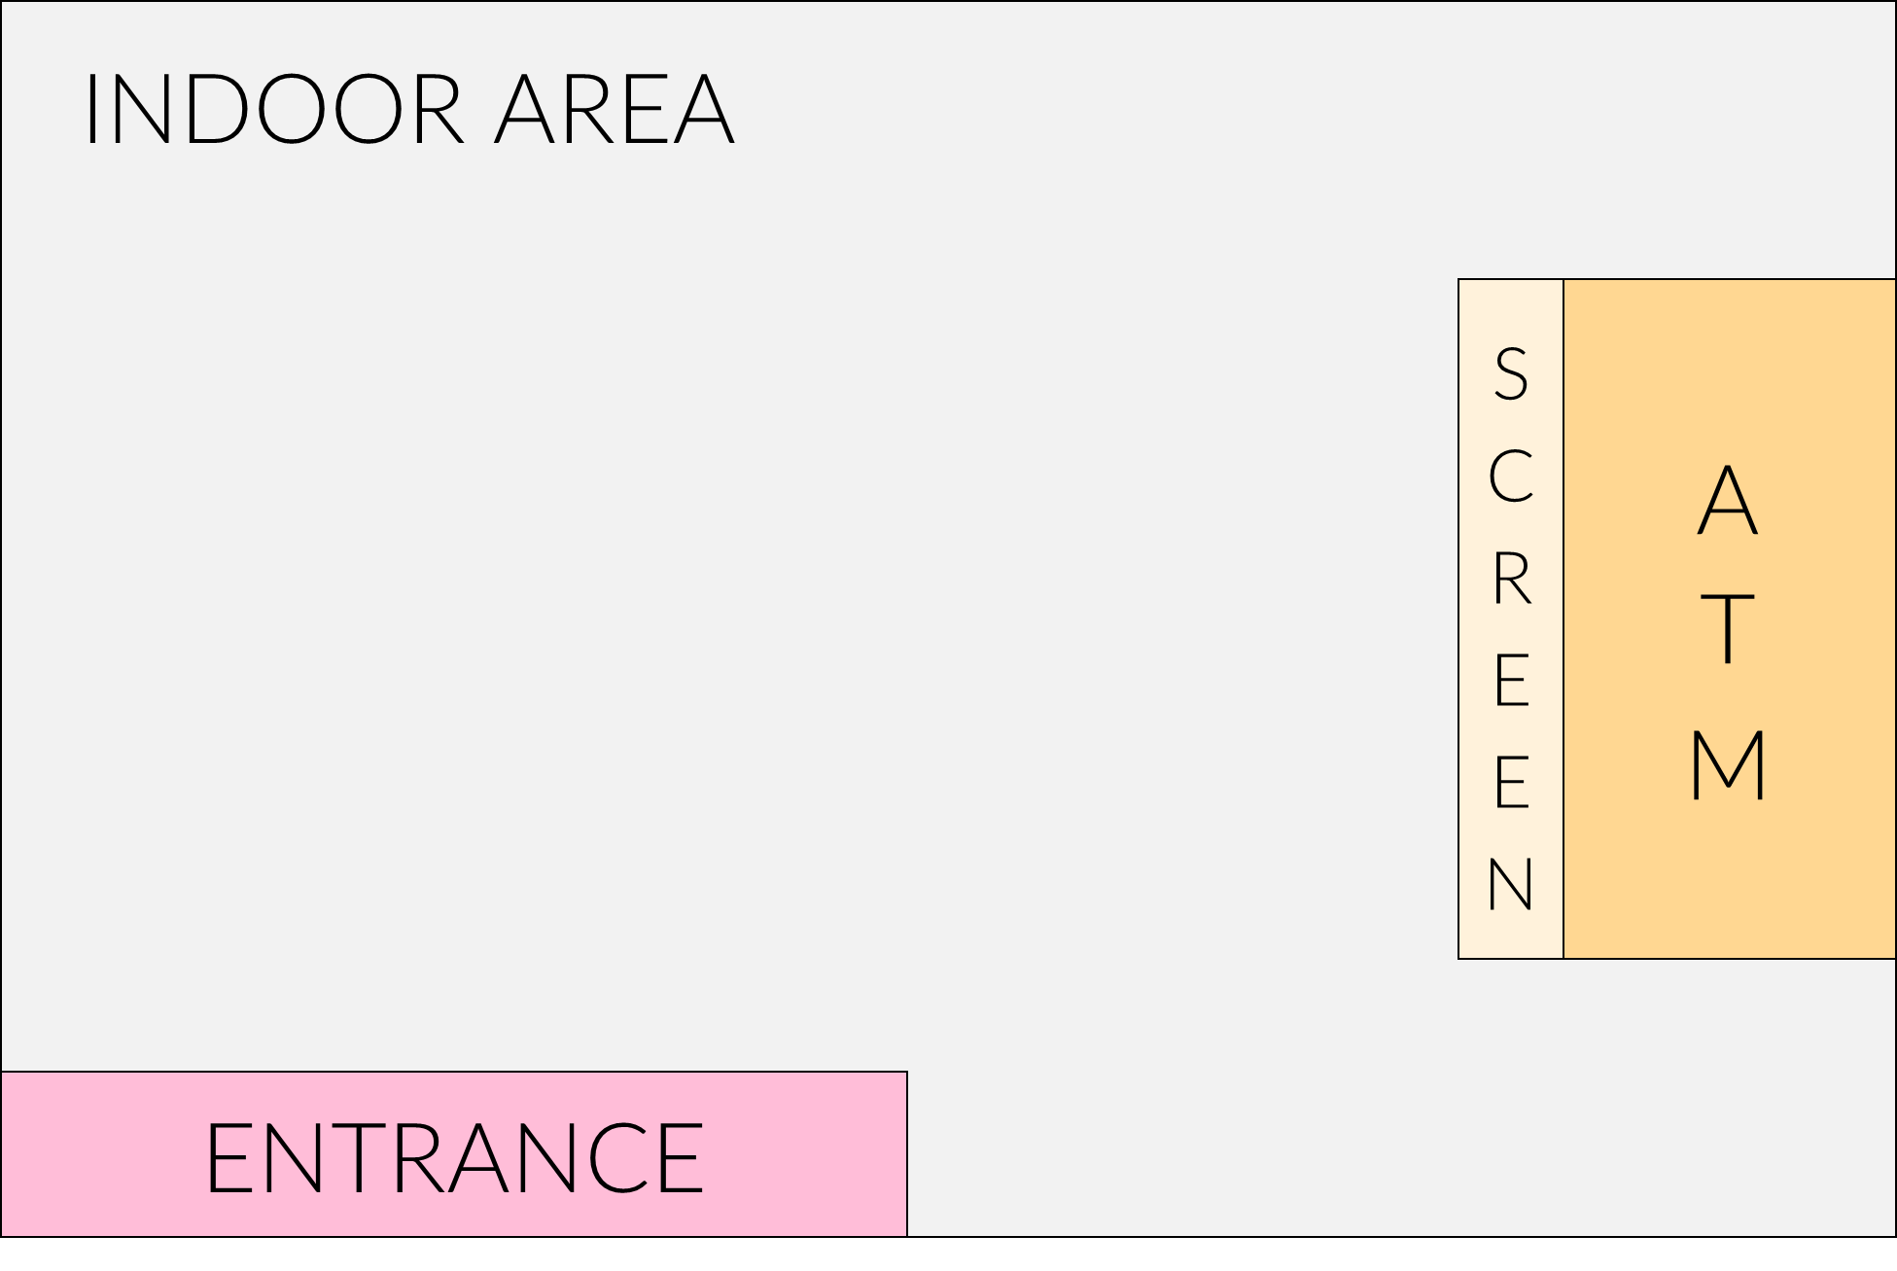
FINSTIX Hierarchy
Organization
SuperBank
Area
Indoor
Area
Entrance
Area
ATM area
Probe
Entrance CCTV
Area
ATM screen
Asset
ATM
Probe
Screen CCTV
Probe
ATM CCTV
Asset
Vault
Asset
Computer
Probe
Network probe

Slide 11
Conclusions
A data model is fundamental for the full integration of the security services
The data model must consider all the requirements of the security services
Cyber aspects
Physical aspects
A data model which integrates cyber and physical security did not exist
FINSTIX extends STIX2 to cope with logical and physical incidents
FINSTIX can be used in any context of Critical Infrastructure
More details on FINSTIX in the supplementary material

Slide 12
Thank you for your kind attention!
Contact me!
Giorgia Gazzarata
DIBRIS, University of Genoa, Italy
CINI, Italy
giorgia.gazzarata@dibris.unige.it

