Slide 1



Securing Critical Infrastructures In The Financial Sector
ATM Network Protection
H2020 FINSEC – No 786727
1

Slide 2
FINSEC Course on ATM Protection Use Cases

Slide 3
Main Goal
ATMs continue to be a profitable target for criminals, who use various methods to generate illegal revenue. While some rely on physically destructive methods through the use of metal cutting tools, others choose malware infections, enabling them to manipulate cash dispensers from the inside.
Actual ATM network issues:
No cyber – physical integration
No cross institution info, behaviors, common threats database
No predictive approach/tools

Slide 4
ATM vulnerabilities
Every ATM is structured in 2 compartments: cabinet and safe. The ATM-PC (and its peripherals-shown in the next slide) is located in the cabinet. The cabinet is practically unprotected, with thin metal or plastic door secured by a trivial lock, which is why criminals can use simple tools or a lock key purchasable online to break into it, in order to gain access either to the computer or the safe.
The safe is more robust, being made of steel and concrete to meet the CEN regulations. The cash dispenser is inside of the safe where the cash cassettes are located.
A compromised computer can easily give criminals access to the controller between the computer and the cash dispenser to command it to dispense cash without using stolen customer card information.

Slide 5
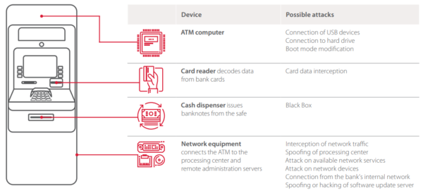
ATM vulnerabilities

Slide 6
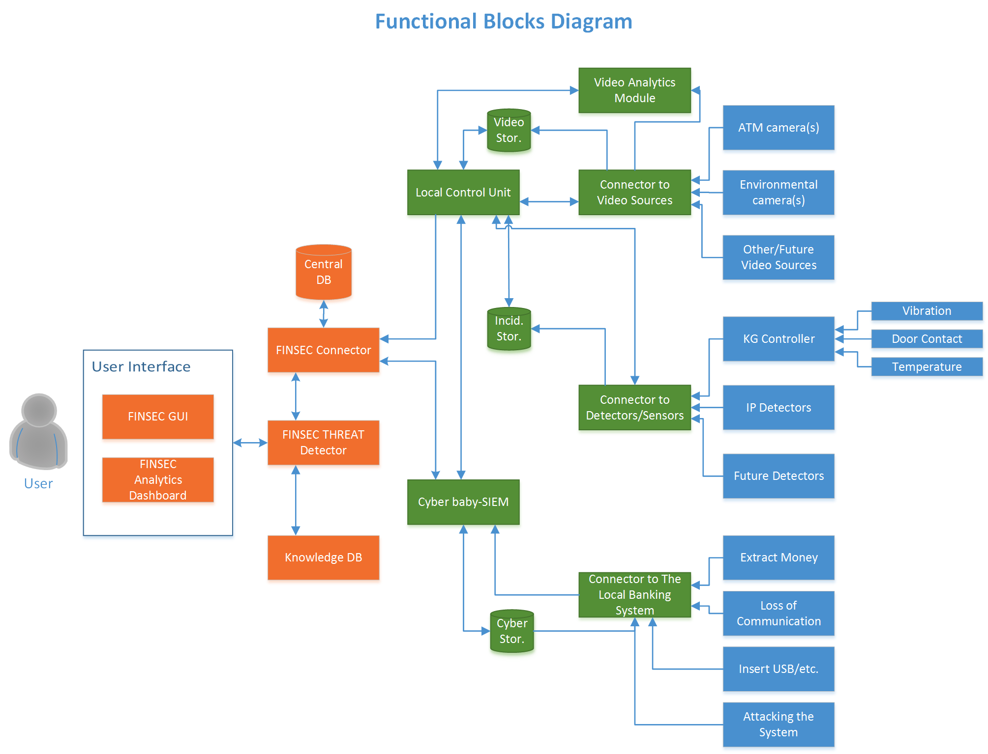
Technical Architecture of ATM Pilot Scenario

Slide 7
Use cases description

Slide 8
SIBS-Romania has design 5 Uses Cases (Attack Scenarios) to cover a wide range of ATM attacks
UC1 - Physical attack to the customer
UC2 - Physical attack to the ATM
UC3 – Loitering
UC4 - Cyberattack such as malware to ATM-PC or the ATM-network
UC5 - Jackpotting with malicious software

Slide 9
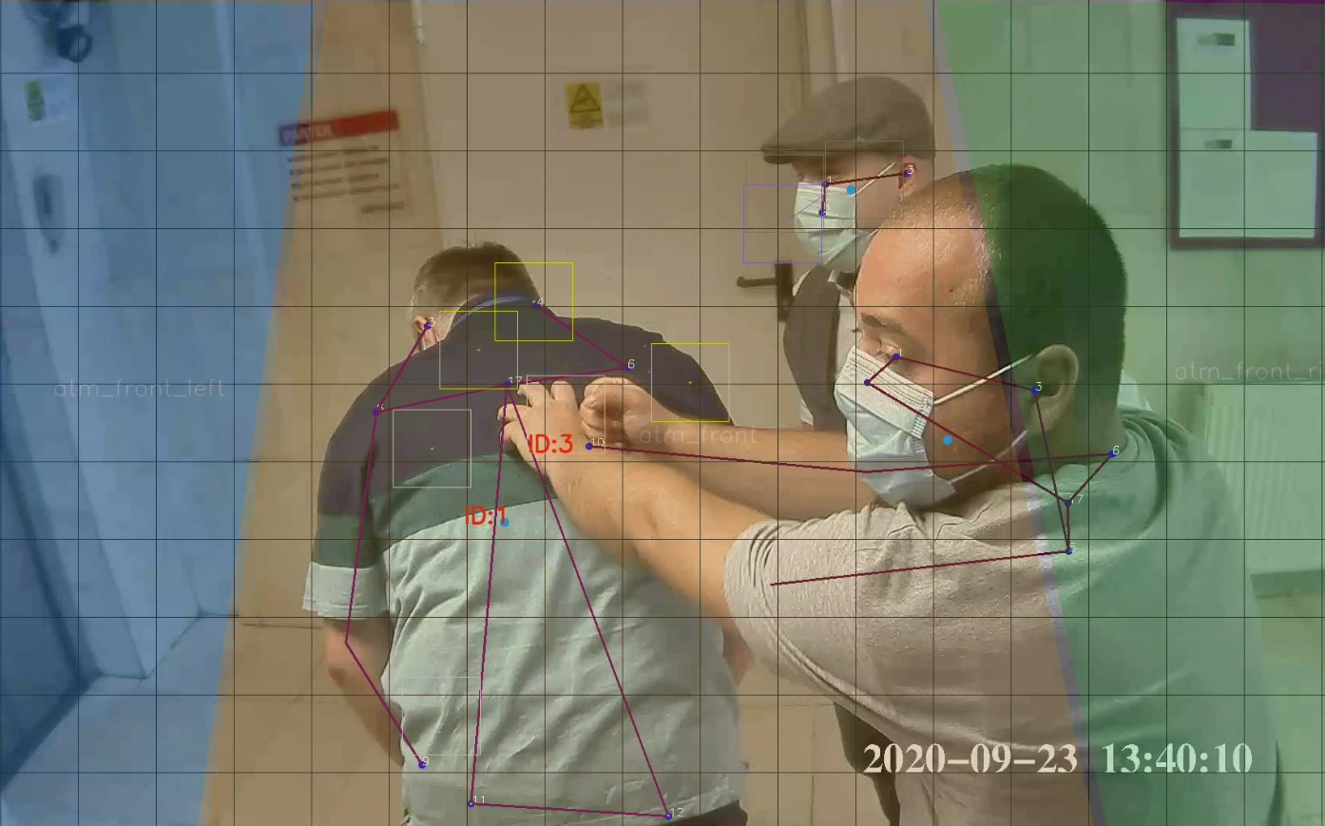
UC1 - Physical attack to the customer
Scenario:
In this scenario we have a possible targeted attack performed by two attackers assaulting the client that just redraw money from the ATM.
CCTV analyzed the video streams and detected that the conditions for an attack to person were met and pushed the event to the FINSEC platform and the Anomaly Detection algorithm mapped this to an attack.

Slide 10
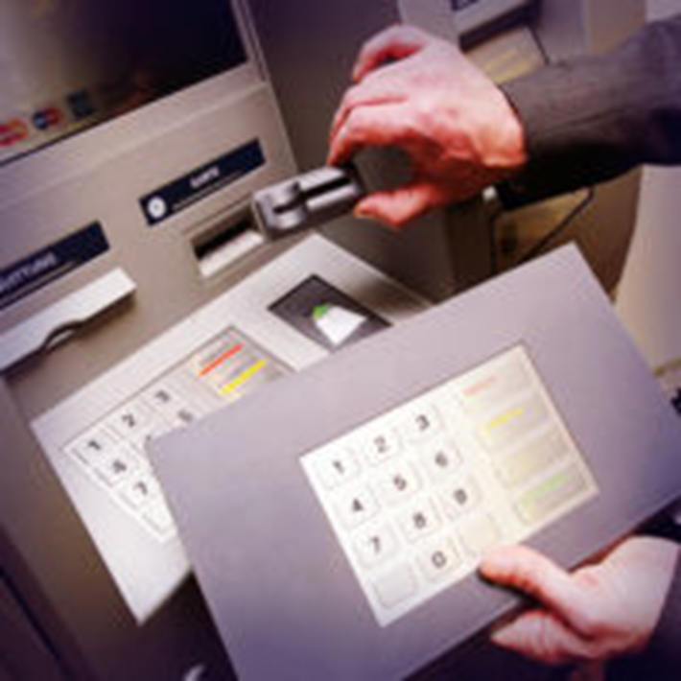
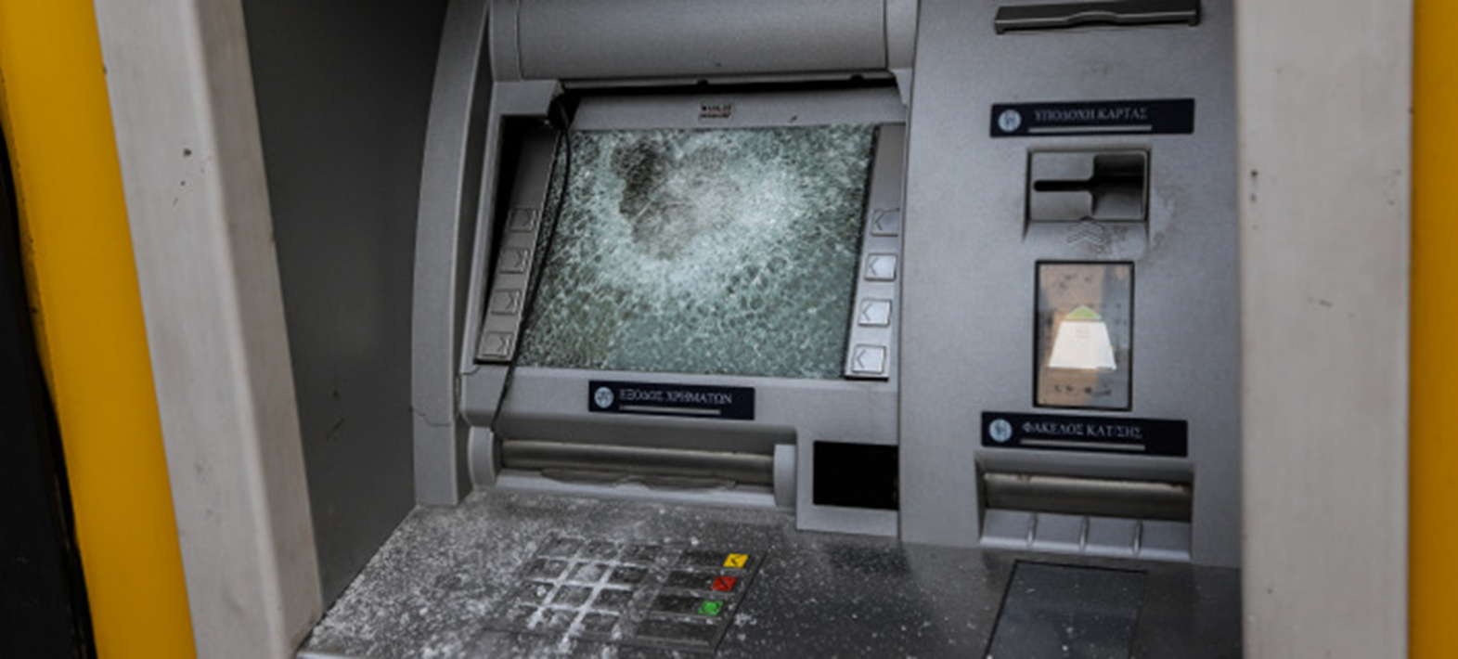
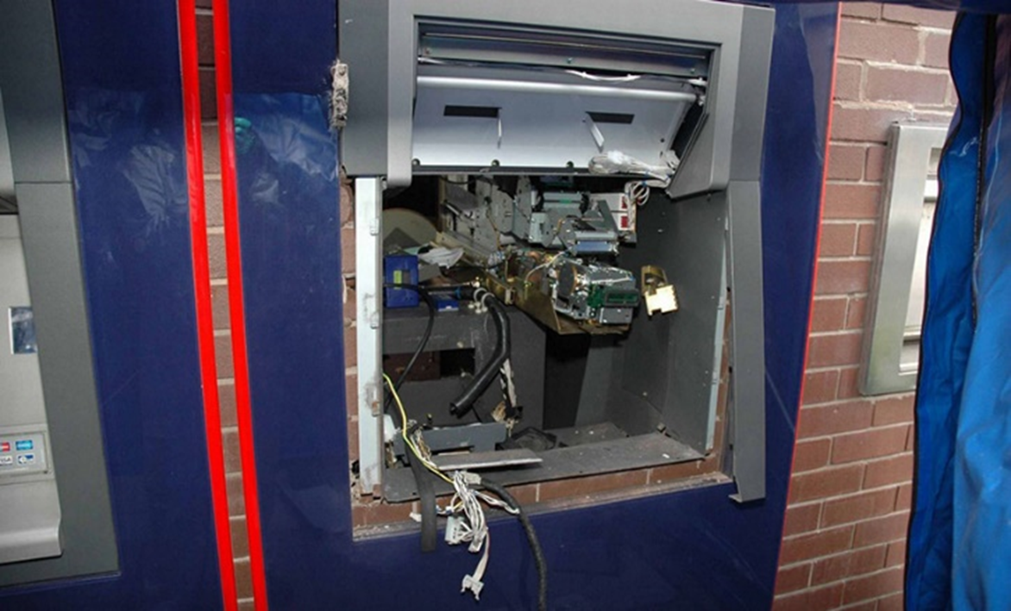
UC2 - Physical attack to the ATM
Scenario:
Possible targeted attack to the ATM itself and its components, blowing the ATM by gas insertion in the safe to steal the cash cassettes or taking the whole ATM.
This Use Case has 3 different sub-scenarios ilustrated below:
• Sub-scenario (A): Attacker is installing a skimmer in the ATM Card reader
• Sub-scenario (B): ATM attack with a hammer - vandalism
• Sub-scenario (C): ATM attack with gas – gas explosion in the ATM safe
The Access Control Probe detected the door, shock and gas events and pushed them to the Finsec Platform, these were mapped to attacks by the Anomaly Detection algorithm.

Slide 11
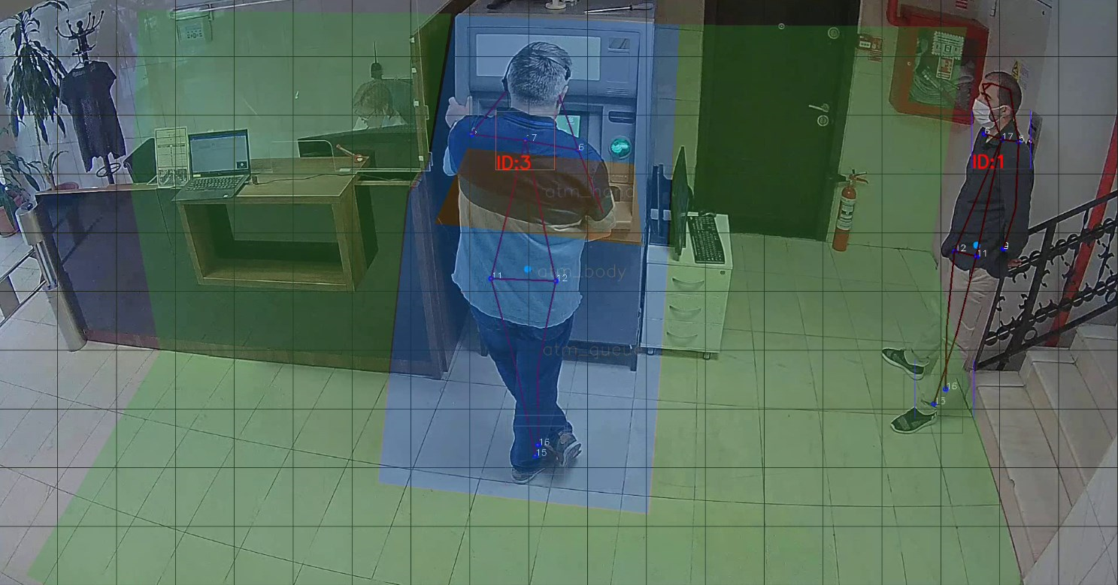
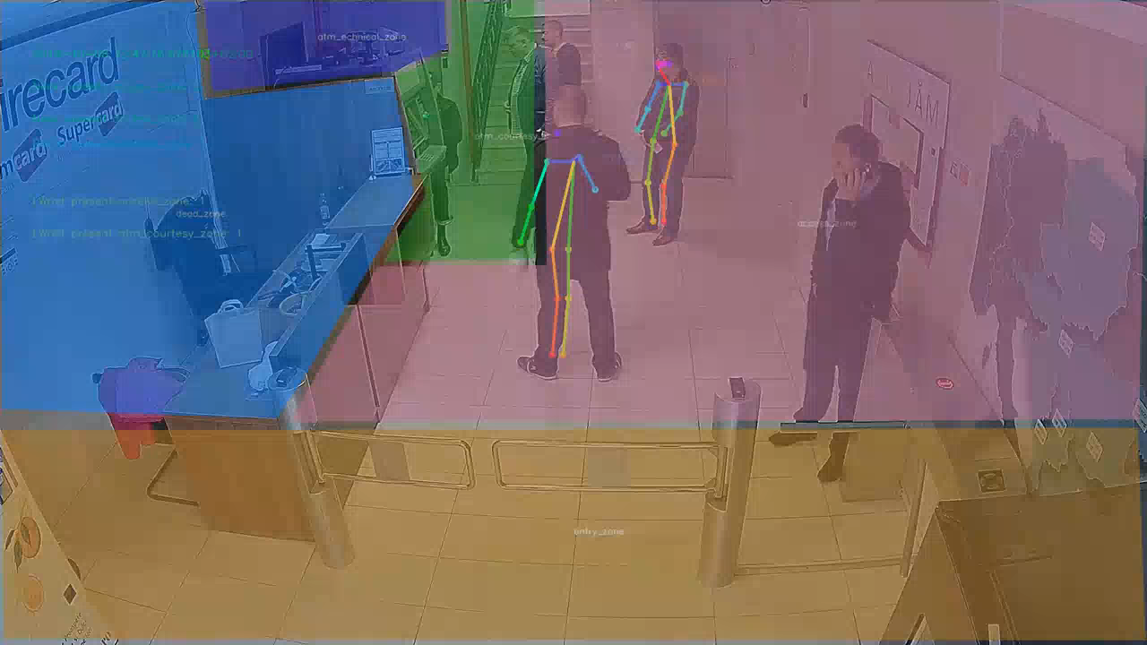
UC3 – Loitering
Scenario:
Loitering is the act of remaining in the vicinity of the ATM for a prolonged time, without any apparent purpose. The Loitering attack scenario consist in identifying person(s) that performs activity in the vicinity of the ATM without using the ATM.
CCTV detected person(s) entering ATM zone and remaining in the zone. These were mapped to attacks by the Predictive Analitics algorithm.

Slide 12
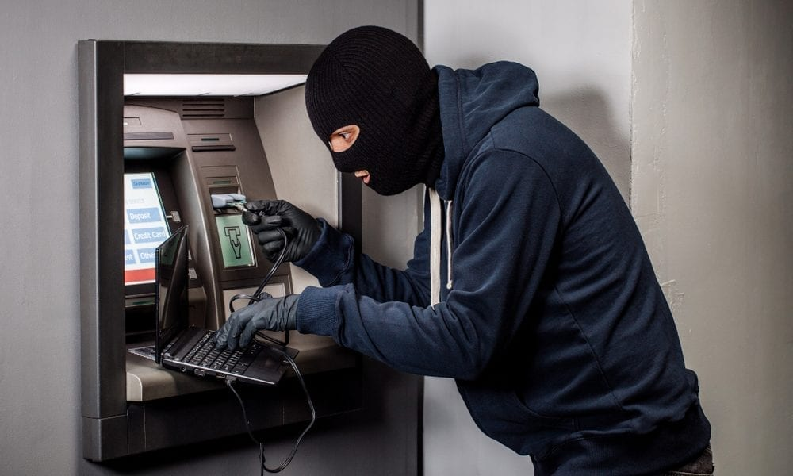
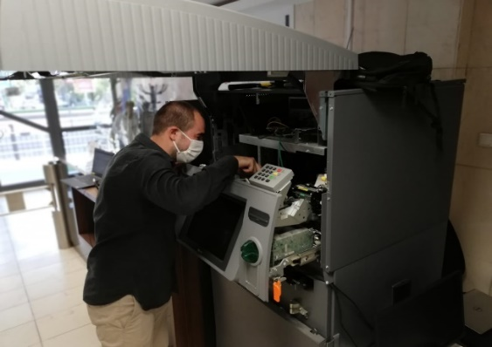
UC4 - Cyberattack such as malware to the ATM-PC or the network
Scenario:
Attackers forced to open the ATM cabinet door, or drilled the ATM panel in order to insert a memory stick in ATM-PC usb port. Injecting a Malware into ATM-PC (like Ploutus, Anunak/Carbanak, Cutlet Maker, SUCEFUL) and also install a physical device to get access to the ATM-PC or to get the data (pin no.) and physicaly copy (clone) the Card. Once an attacker gains access to a bank’s network, they can install malware from a remote location transforming the ATM into a slave machine. The final stage would be for the attacker to send instructions directly to the ATM, command it to dispense the money, and send other person (mule) to collect it.
UC4 it’s a combination of Physical Attack (door and shock sensors) followed immediately by a Cyber Attack. This scenario is designed to prove the abilty of the FINSEC platform to detect cyber-physical attacks. This is a complex scenario were all the probes are involved and information is correlated from both cyber and physical domains. Each involved probe has detected the corresponding related events. These were mapped to attacks by the Anomaly Detection algorithm and the FINSEC Platform proved it’s intelligence by launching the shutdown command of the ATM in order to mitigate loss.

Slide 13
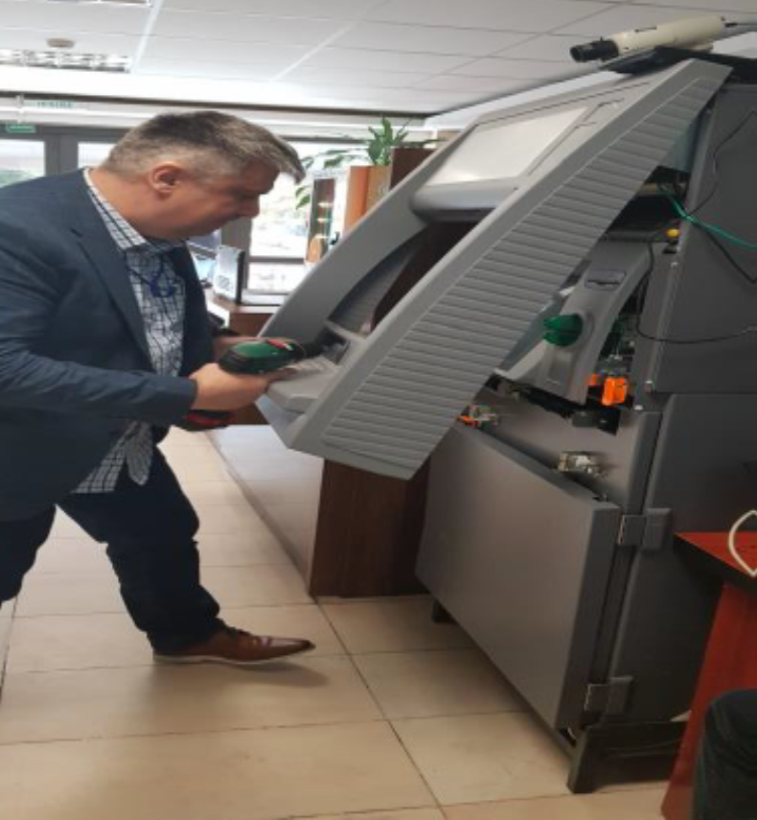
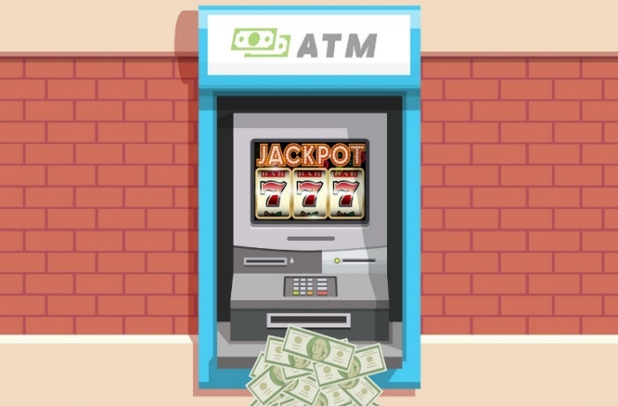
UC5 - Jackpotting with malicious software
Scenario:
Jackpotting - also known as “black box attack” - refer to attacks in which an ATM is manipulated to dispense all it’s cash. Attackers can take local control of an ATM and empty the cash cassettes. They can repeat the procedure in a loop until the ATM is empty of cash.
Attackers forced to open the ATM cabinet door, or already have the cabinet door key from an insider.
This is also a complex scenario were all the probes are involved and information is correlated from both cyber and physical domains.
Each involved probe has detected corresponding related events. These were mapped to attacks by the Anomaly Detection algorithm and the FINSEC Platform proved it’s intelligence by launching the shutdown command of the ATM in order to mitigate loss.

Slide 14
Contributors
The technological partners involved in the Use Cases leaded by SIBS Romania regarding ATM cyber-physical protection are:
  SIBS – Use Case leader - SIBS is involved in the technical requirements definition for the ATM protection.
  IBM: cyber threat detection - IBM is providing expertise in anomaly detection technology to the financial domain and the use-cases of the project.
  UTI: physical attack detection - UTI is contributing in developing a Cyber-physical Security Management Appliance for the protection of ATM networks.
  Fujitsu: Video Analytics - FUJITSU is providing its expertise in the area of CCTV evaluation based on image processing, analytics and AI covering physical security topics protecting ATMs and branch offices.

